Slide 1
Data Management Final Project Review:
WDB + TitanDB and APEX Mobile App
Raymond Chee & Qicong Deng
Group: D2
CS 347, Dr. Cannata, Fall 2015

Slide 2
Part One
WDB + TitanDB

Slide 3
What is WDB?
WDB stands for the Web Database, an implementation of the Semantic Data Model (SDM)
Offers two types of attributes: data-valued attributes (DVAs) and entity-valued attributes (EVAs)
DVA defines a displayable value of an entity
EVA establishes a bidirectional relationship between the entity in its owning class and the entities of a target class
Notes:
Despise this, the game was extremely popular and became a stepping stone of the Video game industry.

Slide 4

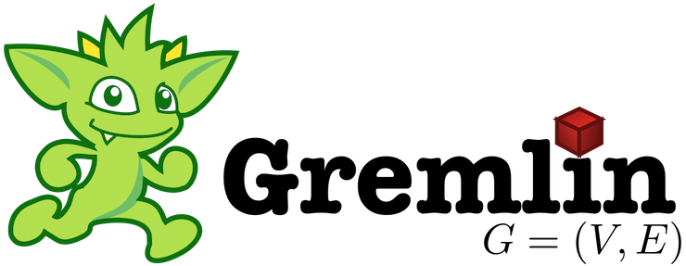
What is DB?
Highly scalable graph database optimized for storing and querying large graphs with billions of vertices and edges distributed across a multi-machine cluster
Transactional database that can support thousands of concurrent users, complex traversals, and analytic graph queries
Native support for the graph traversal language Gremlin

Slide 5
What is the result?
What we achieved
Building the TitanDB with the backend of BerkeleyDB
Populating the data into the TitanDB with ODL (Object Definition Language)
Retrieving data from the TitanDB with OML (Object Manipulation Language)
How did we achieve it?
Redesigned the previous implementation that was using Gremlin
Utilized the parse tree of WDB and re-implemented SIM with TitanDB API in native Java

Slide 6
Technical Demo

Slide 7
Part Two
APEX Mobile Application

Slide 8
APEX Mobile Application
Gives an overview of NBA teams from different conferences and information about players from each team
Features one query page + three reports
NBA Query page where user can manually enter SQL to get data from the server in JSON format
NBA Teams report shows user the NBA teams and the conference each team competes in
NBA Players report shows user information about some players from each team and their information such as position and height
NBA Stats report shows user information about the count of the position and height in two graphs

Slide 9
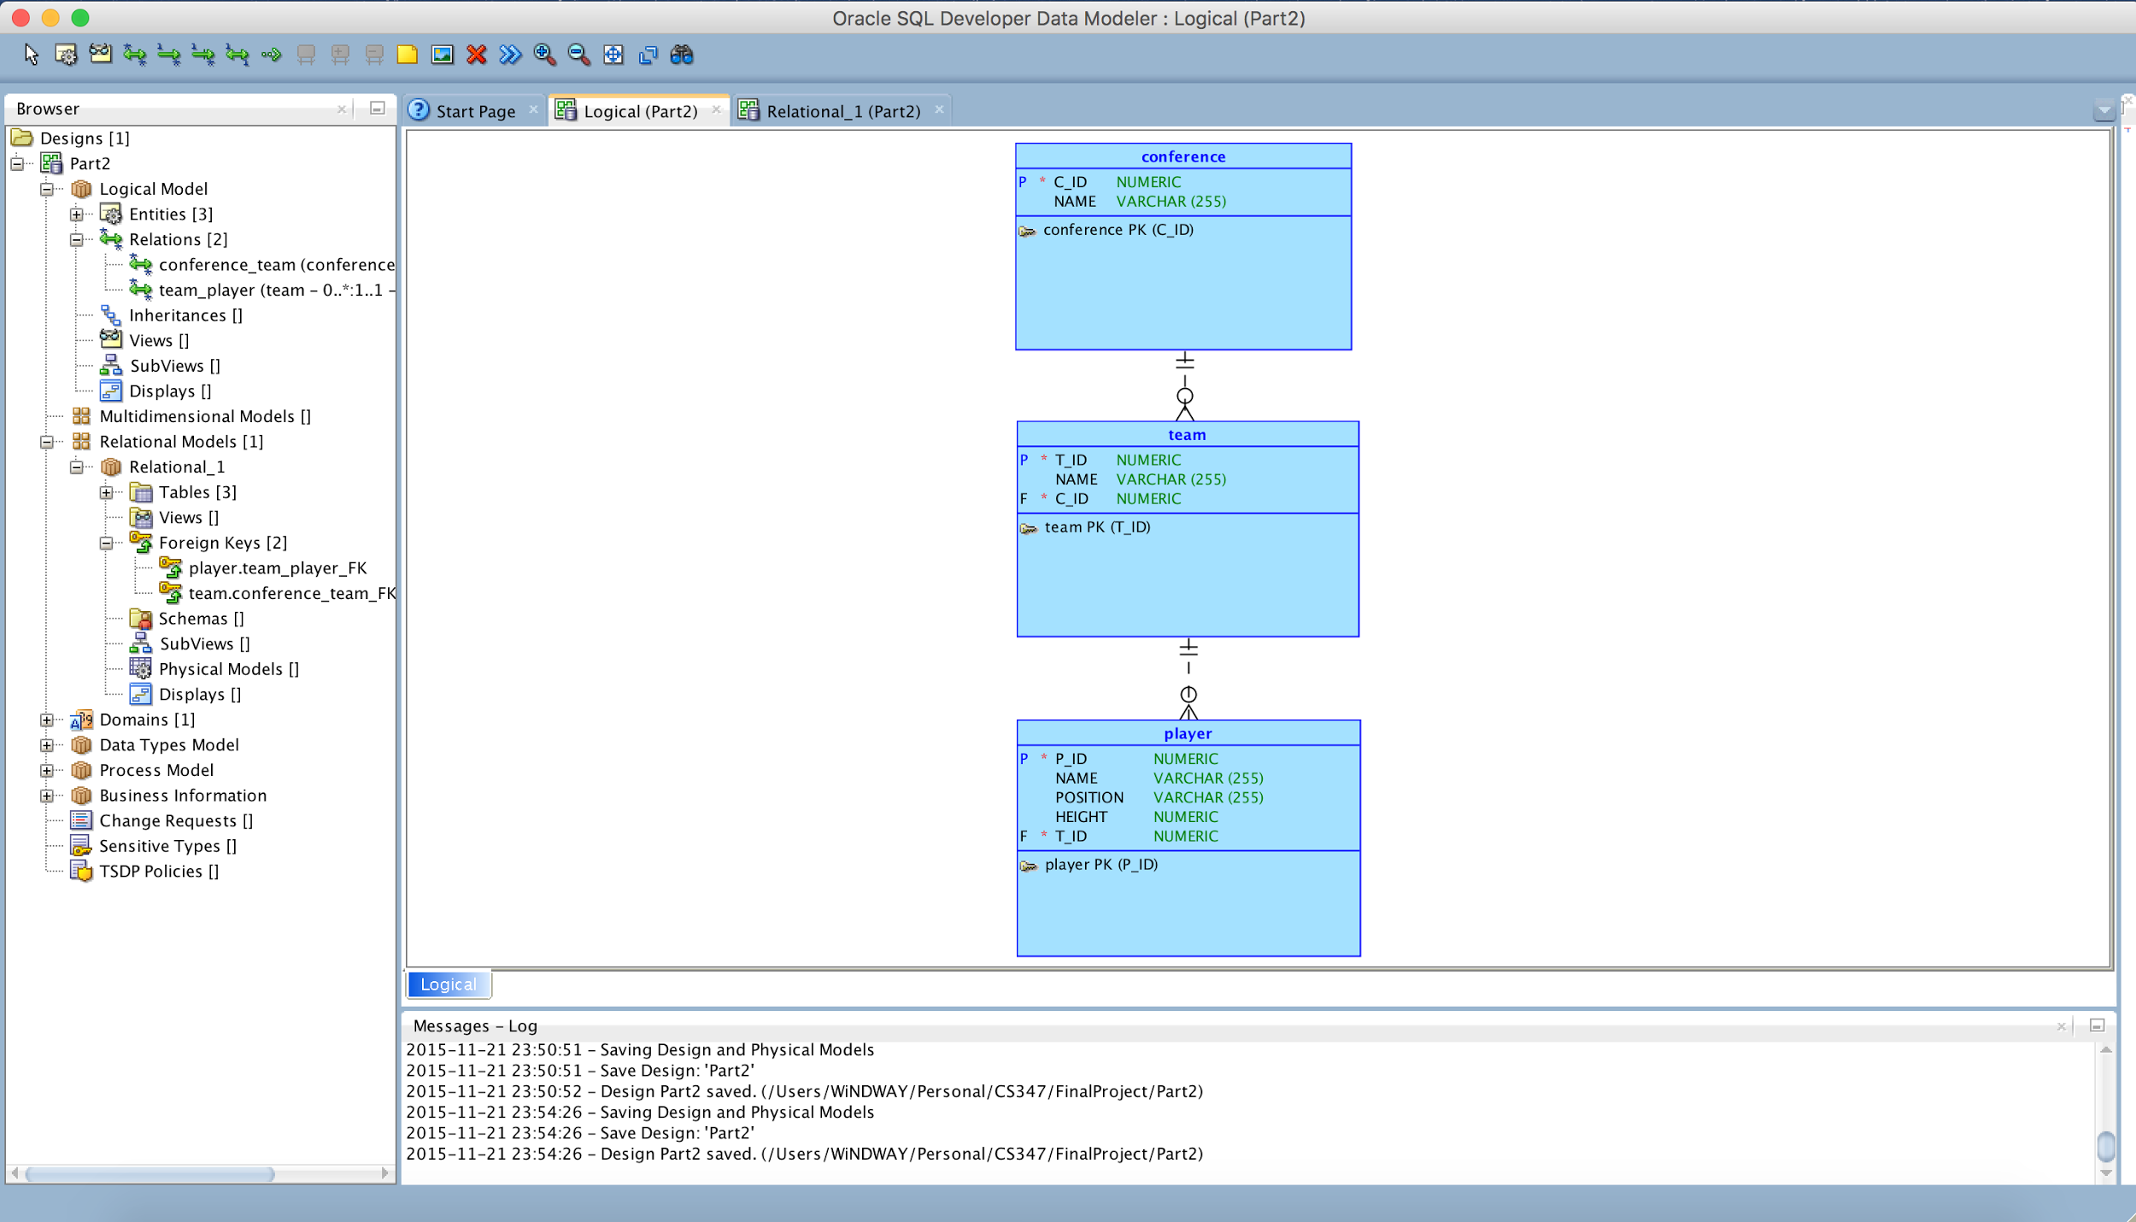
Conceptual Model

Slide 10

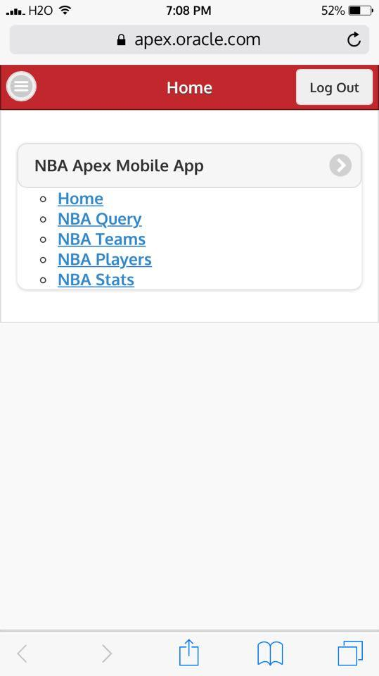
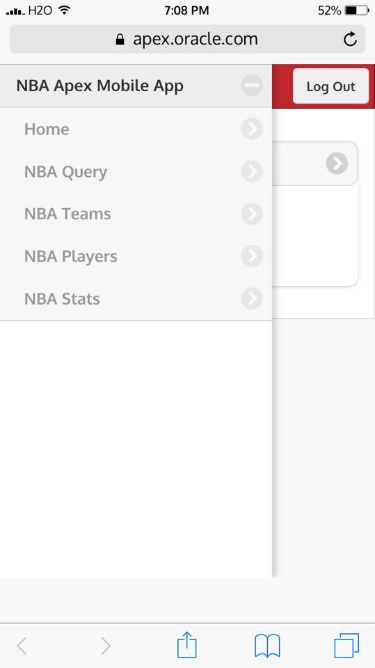
Landing Page

Slide 11
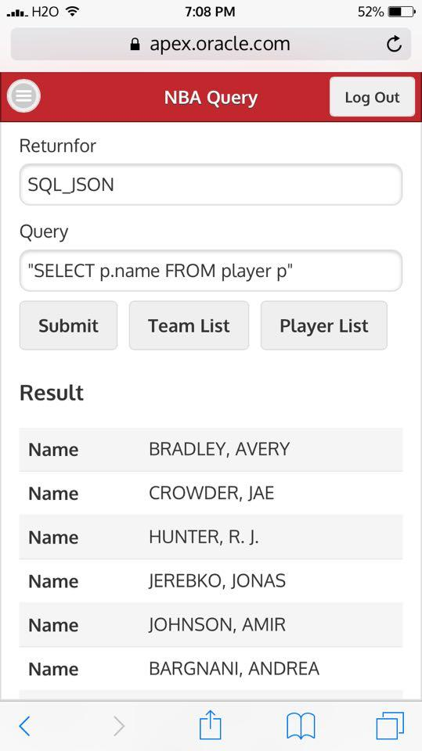
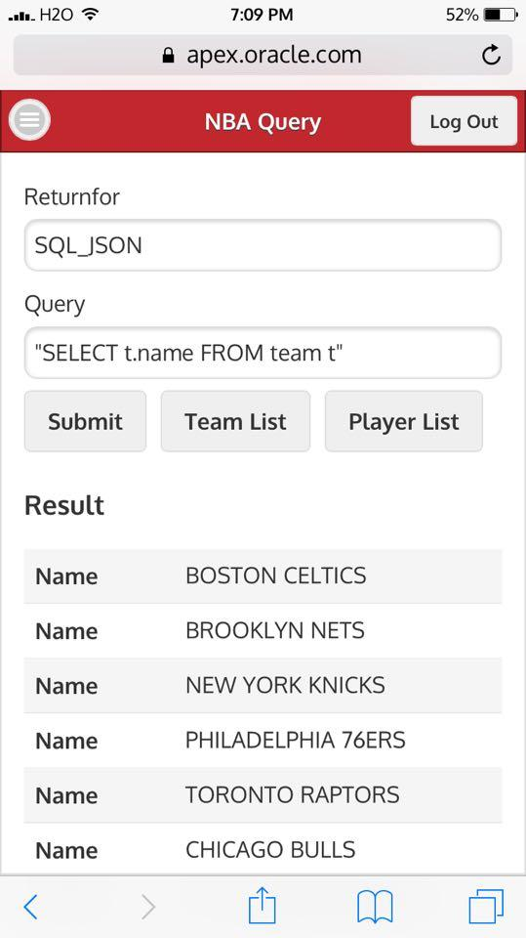
NBA Query

Slide 12
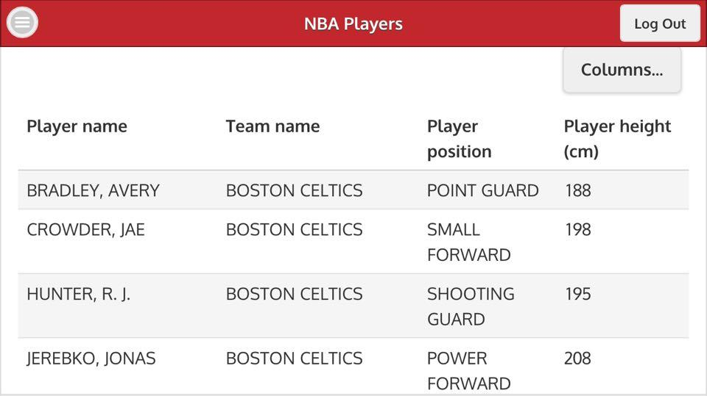
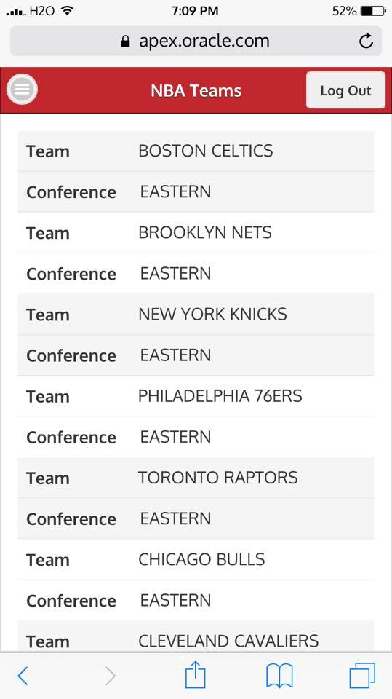
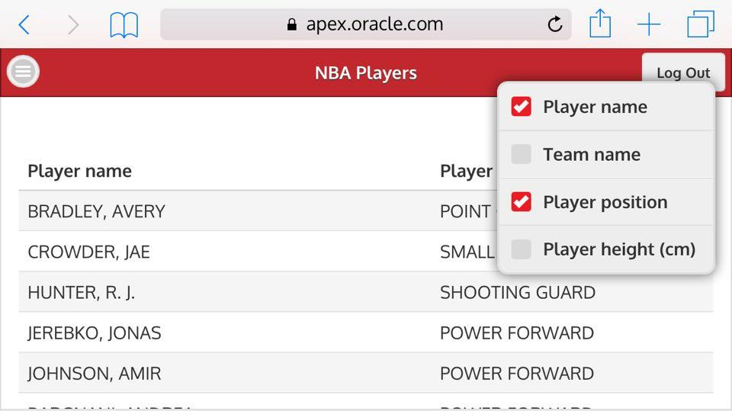
NBA Teams + Players

Slide 13
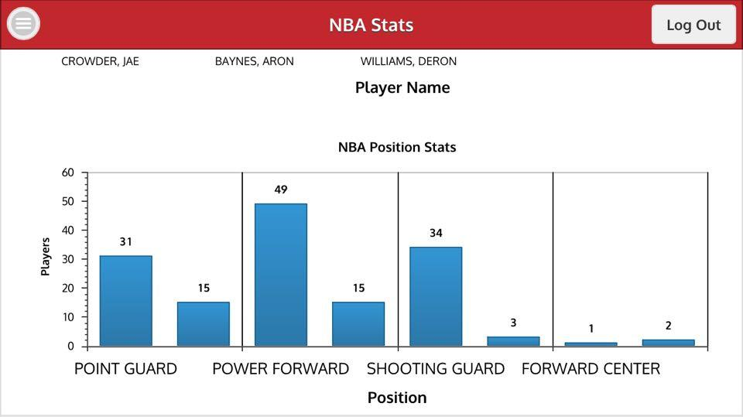
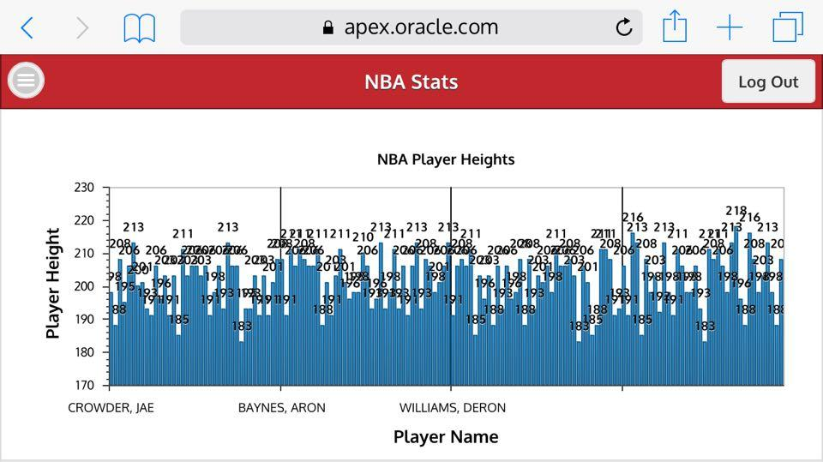
NBA Stats

Slide 14
What have we learned?

Slide 15
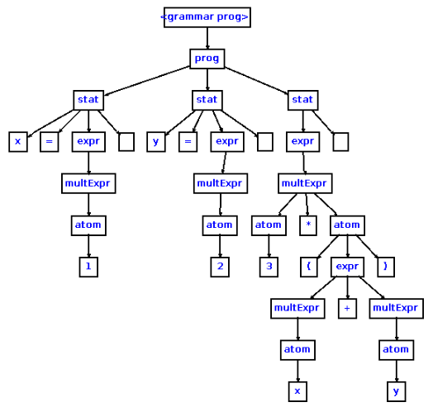
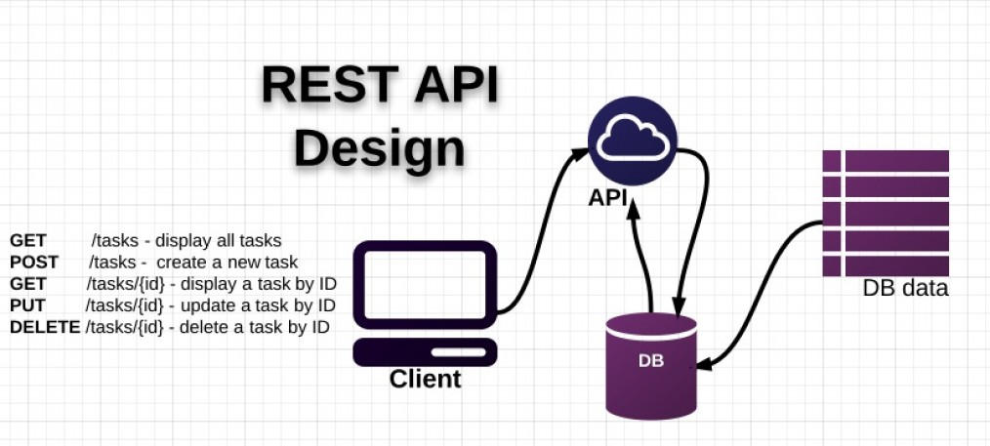
What did we learn?
Learned a new graph traversal language Gremlin
Exposed to the workflow of TitanDB and TinkerPop
Grasped the idea of representational state transfer (REST) through APEX
Understood the data structure of parse tree through WDB

Slide 16
Questions?

